Slide 1
Animatronics
Python with Robots Mission 4
Lesson 4 Objective 12

Slide 2

Pre-Mission Warm-Up
In your Mission 4 Lesson 4 log, answer the pre-mission warm-up questions:
What lines of code pause the program and wait until a button is pressed?
How do you define and call a function?

Slide 3
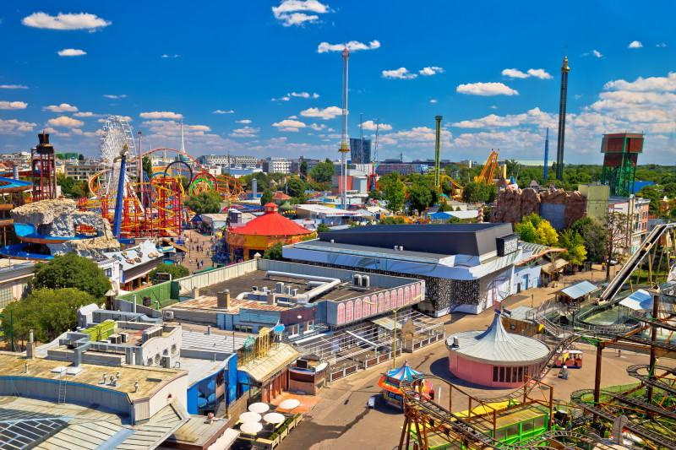
Mission 4: Animatronics
Review: You are hired by a major Theme Park!
Your task is to create a new animatronic robot exhibit.
Gotta write some Python code and get the show running with CodeBot!

Slide 4
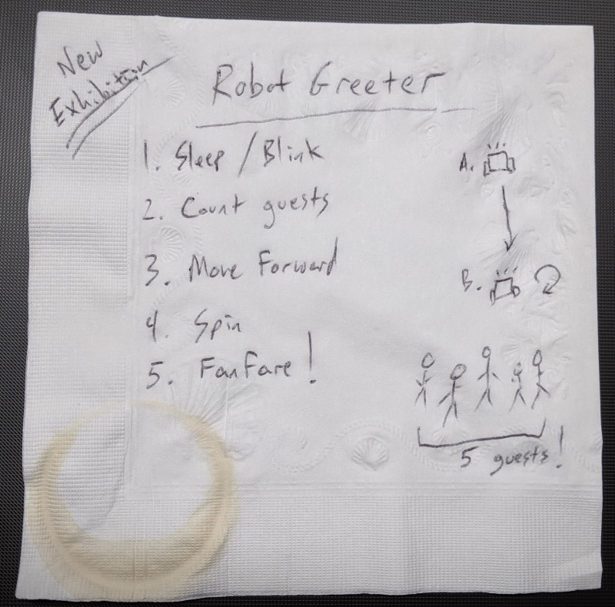
Mission 4: Animatronics
Review the notes on the napkin sketch.
You created programs that accomplish all of the steps, except the fanfare isn’t complete.
Goals:
Complete the fanfare.
Combine the individual programs into one complete project.

Slide 5
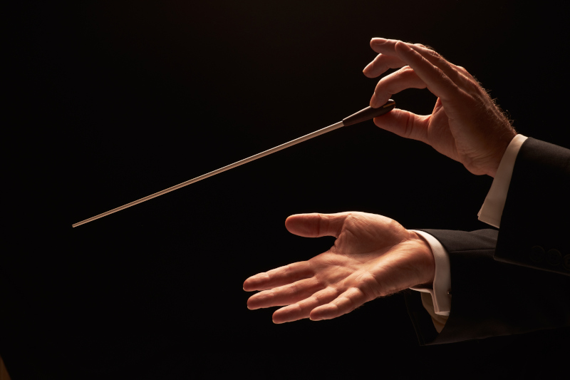
Objective #12: Putting It All Together
Turning the notes into Fanfare!
At the end of Lesson 3, you created a function that plays a note, and then called the function to play a single note.
Time to complete the music.

Slide 6
Objective #12: Putting It All Together
Open RobotMoves, your program from Lesson 3.
Go to File – Save As… and give your program the name Animatronics

Slide 7
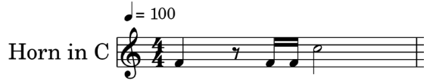
Objective #12: Putting It All Together
Now, decode the musical notation into something that you can write Python code for.
There are just two pitches in this music:
F4 – 349 Hz
C5 – 523 Hz
Rest

Slide 8
Objective #12: Putting It All Together
Musical timing is in “beats”.
The table on the next slide shows the timing of the tune.
Each 1/16 equals 0.1 second

Slide 9
Objective #12: Putting It All Together
Note | 1/16 Beat | Frequency | Seconds
F4 | 4 | 349 Hz | 0.4
rest (sleep) | 2 | – | 0.2
F4 | 1 | 349 Hz | 0.1
F4 | 1 | 349 Hz | 0.1
C5 | 8 | 523 Hz | 0.8

Slide 10
Objective #12: Putting It All Together
DO THIS:
Define a constant for F4 and C5.
A constant is like a variable, but the value doesn’t change.
It is designated with a name in ALL CAPS.
Constants are usually defined near the top, just under the imports.

Slide 11
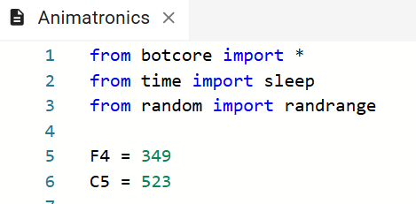
Objective #12: Putting It All Together

Slide 12
Objective #12 Putting It All Together
DO THIS:
Complete the fanfare by calling the note() function for each note.
Use the constants F4 and C5 instead of their frequency.
Try doing this on your own. Then check the code on the next slide.

Slide 13
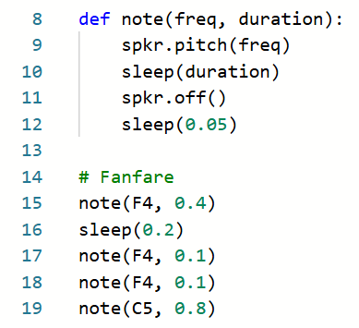
Objective #12 Putting It All Together

Slide 14
Objective #12: Putting It All Together
One more thing…
The fanfare should be at the END of the program, not at the beginning.
Move the code that plays the fanfare to the end of the program.
The constants and function definition can stay near the top.
You can add a short pause before playing the fanfare.

Slide 15
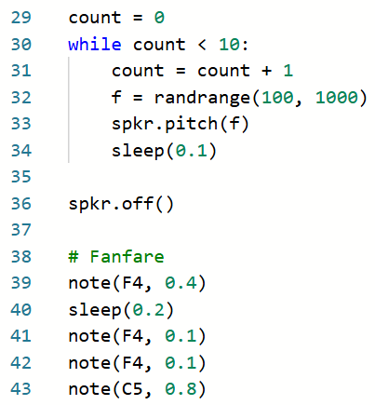
Objective #12 Putting It All Together

Slide 16

Using the Cute Robot Sounds
Moving the fanfare to below the cute robot sounds reminds us that we still have work to do here as well.
We want the cute robot sounds to play WHILE the robot is spinning, not after.
We can use the time it takes to play the cute sounds as the sleep delay.

Slide 17
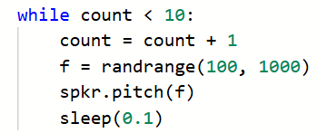
Using the Cute Robot Sounds
Time for some math!
Calculate the specific number for the cute robot beeps.
Right now, the number is 10.
This means you will play 10 random beeps each second.

Slide 18
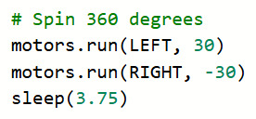
Using the Cute Robot Sounds
Time for some math!
Now look at the amount of delay in your sleep() function call.
Multiply that number by 10.
Change the specific number in the while loop to that number.
Fill out this information in your mission log.

Slide 19
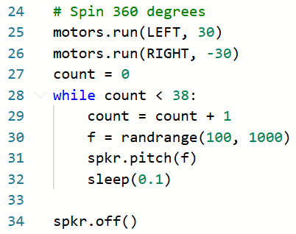
Using the Cute Robot Sounds
DO THIS:
Delete the sleep() function from the # Spin 360 degrees section.
Change the specific number in the while loop to the calculated number.

Slide 20
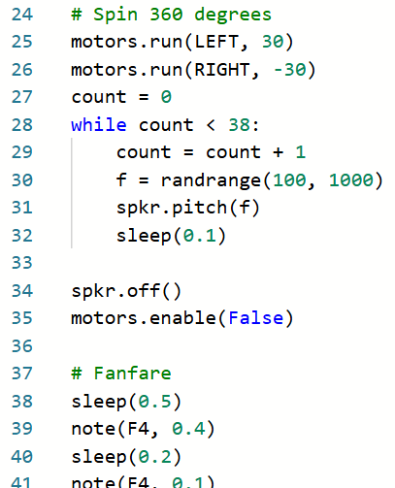
Using the Cute Robot Sounds
DO THIS:
Turn the motors off.
Add a short pause before playing the fanfare.

Slide 21
Using the Cute Robot Sounds
DO THIS:
Run the program.
The ‘bot should wait patiently for you to press BTN-0.
Then it should
Move forward 2 feet.
Spin 360 degrees while playing cute beeps.
Stop.
Play the fanfare.
Have the program working correctly before continuing.

Slide 22
Animatronics
Pretty cool….right?!
This program does steps 3, 4 and 5.
Time to put it all together for one complete project.
This program is going to be long!
Let’s keep it organized by using comments for each section.

Slide 23
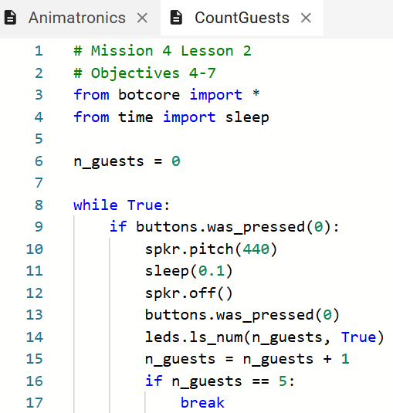
Animatronics
DO THIS:
Keep the Animatronics file open.
Open the CountGuests file.

Slide 24
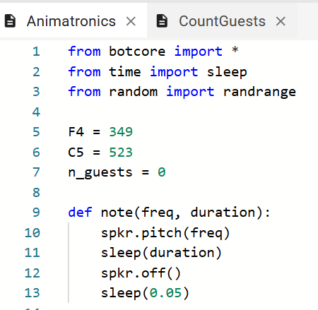
Animatronics
DO THIS:
Copy and paste the n_guests variable from CountGuests to Animatronics.
Variables, like constants, are often defined near the top of a program file.

Slide 25
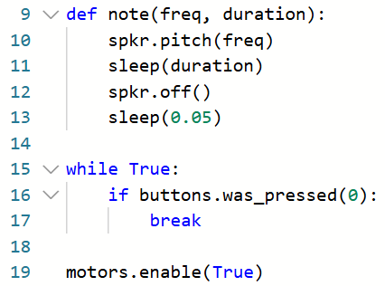
Animatronics
DO THIS:
In Animatronics, delete the while loop that pauses the program and waits for a button press.
You will replace it with the while loop from CountGuests.

Slide 26
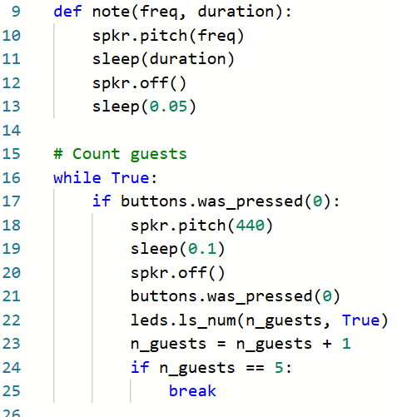
Animatronics
DO THIS:
Copy the while True loop from CountGuests and paste it in Animatronics, where the other while True loop used to be.
Add a comment for this section.

Slide 27
Animatronics
DO THIS:
Run the program.
Press the BTN-0 five times.
Then the program should move forward, spin and play the fanfare.
Have the program working correctly before continuing.

Slide 28
Animatronics
Pretty cool….right?!
Final step.
Add the code for sweeping LEDs until 5 guests have pressed BTN-0.
You can close CountGuests.

Slide 29
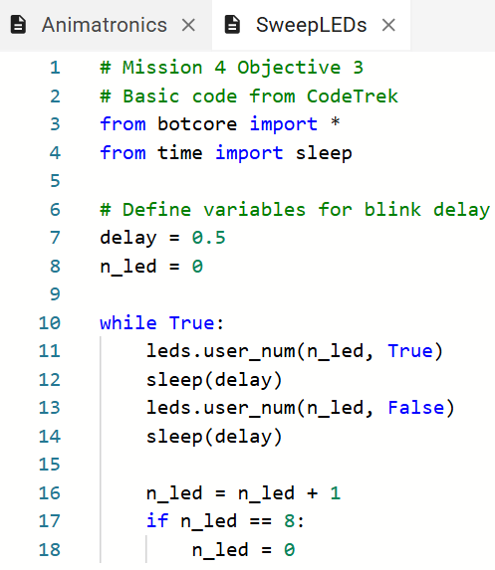
Animatronics
DO THIS:
Keep the Animatronics file open.
Open the SweepLEDs file.

Slide 30
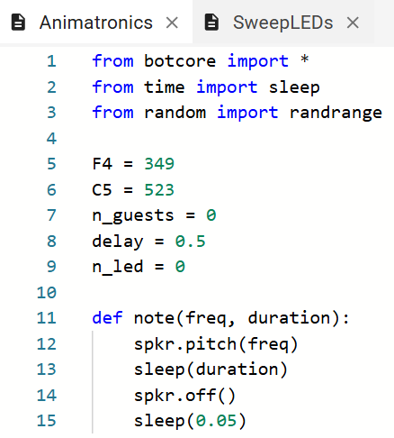
Animatronics
DO THIS:
Copy and paste the two variables from SweepLEDs to Animatronics.

Slide 31
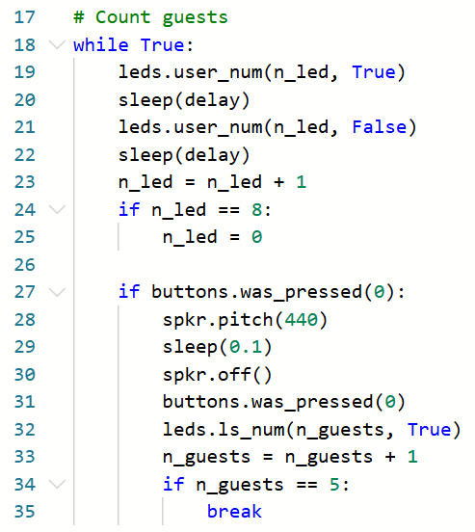
Animatronics
DO THIS:
Copy the code inside the while True loop from SweepLEDs and paste it in Animatronics, inside the first while True loop.

Slide 32
Animatronics
DO THIS:
Run the program.
Press the BTN-0 five times.
Then the program should move forward, spin and play the fanfare.
Have the program working correctly before continuing.

Slide 33
Animatronics
DO THIS:
Run the program.
The ‘bot should have sweeping lights.
Press BTN-0 five times.
The ‘bot should move forward, spin and play the fanfare.

Slide 34
Animatronics
DO THIS:
After running the program and fixing any bugs, decide on anything you might want to adjust.
Some suggestions:
Decrease the delay to a much lower number for a faster LED sweep.
Adjust the specific number in the while loop for the beeps so the ‘bot goes in one complete circle.
Add a longer fanfare.

Slide 35
Extensions
At the end of the mission, several remix ideas are given:
Make the flashing user LED sequence sweep both ways, left and right.
Increase the number of guests to 15 (using binary). Use leds.ls(n_guests).
Make the button press beep at a higher frequency with each button press.
Use your note() function to play an enchanting melody during the move forward part of the exhibit.

Slide 36
Post-Mission Reflection
Complete the post-mission reflection in your Mission 4 Lesson 4 Log:
What did you learn about programming from this lesson?
What did you learn about yourself from this lesson?

